Slide 1
Edge Security Bootcamp
OAuth - Miscellaneous

Slide 2
Refreshing tokens
Refresh tokens can be used to obtain new access tokens for the original end user
<?xml version="1.0" encoding="UTF-8" standalone="yes"?>
<OAuthV2 async="false" continueOnError="false" enabled="true" name="RefreshToken">
<DisplayName>OAuth Refresh Token</DisplayName>
<Operation>RefreshAccessToken</Operation>
<ExpiresIn>86400000</ExpiresIn>
<ReuseRefreshToken>true</ReuseRefreshToken>
<GrantType>request.formparam.grant_type</GrantType>
<RefreshToken>request.formparam.refresh_token</RefreshToken>
<GenerateResponse/>
</OAuthV2>
curl -v -u "vn0zG4cnSWaWIzdwBZgnREI1NGORDXXz:uZt7LeDbq7vX90NP"
-d "grant_type=refresh_token&refresh_token=LRYvVXXgWwbuEZivoe8XvZE2WPdzX9fp"
"http://myorg-test.apigee.net/v1/oauth/refresh_accesstoken"

Slide 3
Invalidating access and refresh tokens
Access and refresh tokens can be invalidated via policies
“cascade=true” propagates invalidation to all related access and refresh tokens
<?xml version="1.0" encoding="UTF-8" standalone="yes"?>
<OAuthV2 async="false" continueOnError="false" enabled="true" name="InvalidateToken">
<DisplayName>OAuth Invalidate Token</DisplayName>
<Operation>InvalidateToken</Operation>
<Tokens>
<Token type="accesstoken" cascade="true">request.queryparam.access_token</Token>
<Token type="refreshtoken" cascade="true">request.queryparam.refresh_token</Token>
</Tokens>
</OAuthV2>

Slide 4
Access token attributes
Access/refresh tokens and authorization codes can contain attributes
<?xml version="1.0" encoding="UTF-8" standalone="yes"?>
<OAuthV2 async="false" continueOnError="false" enabled="true" name="oauth-generate-token">
<DisplayName>OAuth Generate Token</DisplayName>
<Operation>GenerateAccessToken</Operation>
<ExpiresIn>86400000</ExpiresIn>
<SupportedGrantTypes>
<GrantType>client_credentials</GrantType>
</SupportedGrantTypes>
<GrantType>request.queryparam.grant_type</GrantType>
<Attributes>
<Attribute name=”attr_name1” ref=”flow.variable” display="true|false">value1</Attribute>
<Attribute name=”attr_name2” ref=”flow.variable” display="true|false">value2</Attribute>
</Attributes>
</OAuthV2>

Slide 5
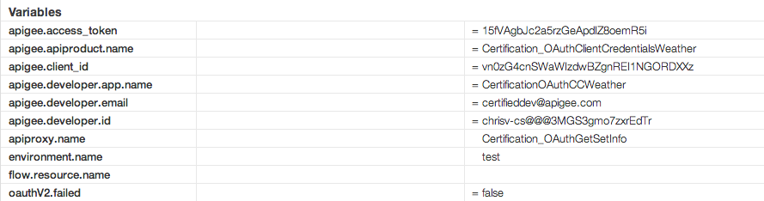
GetOAuthV2Info to retrieve access token attributes
GetOAuthV2Info used to retrieve general info about an access token
GetOAuthV2Info is usually not needed – the OAuthV2 VerifyAccessToken operation now populates similar variables
<GetOAuthV2Info name="GetTokenAttributes">
<AccessToken ref="request.queryparam.access_token"></AccessToken>
</GetOAuthV2Info>

Slide 6
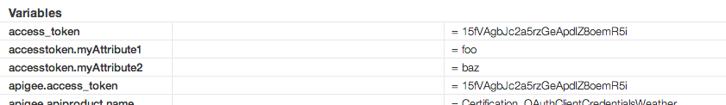
SetOAuthV2Info to set access token attributes
SetOAuthV2Info can be used to set attributes on an access token
which can then be retrieved by validating the token
<SetOAuthV2Info name="SetOAuthV2Info">
<AccessToken ref="request.queryparam.access_token"></AccessToken>
<Attributes>
<Attribute name="myAttribute1">foo</Attribute>
<Attribute name="myAttribute2">baaz</Attribute>
</Attributes>
</SetOAuthV2Info>

Slide 7
THANK YOU

